Slide 1

Data Capture in Retail
Data Capture in Healthcare
Improving Patient Care
Driving Operational Efficiency

Slide 2
Agenda
1
Introduction to Zebra
2
Trends and drivers in healthcare
3
DCS Solutions that drive healthcare transformation
4
Portfolio and products for healthcare applications
5
Zebra – your trusted partner for healthcare data capture and beyond

Slide 3
Introduction to Zebra
1
2
3
4
5

Slide 4
About Zebra Expertise
~$4.2B global sales
7000+ employees worldwide
10,000+ partners worldwide
Healthcare
Manufacturing
T&L
Retail
Data Capture Solutions
Mobile Computing
Specialty Printing
Location Solutions
Data Platforms
Software
Services
Supplies

Slide 5






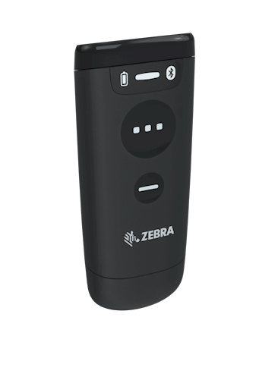


Customer-focused Innovation Behind 50 Years of Industry Firsts
Scanner development timeline*
Triggered handheld laser barcode scanner
Mobile computer combined with barcode scanning and wireless communications into one device
Frictionless scan element doesn’t wear out like conventional motors used in other laser scanners
Patented optics for SE95X Series of miniature scan engine with exemplary working range
Multi-plane imaging scanner with improved throughput due to capturing items from six different directions
1980
1986
1990
1991
1991
2003
2006
2010
2013
2020
Introduced small formfactor laser scanner using laser diode
PDF417 symbology, found on almost every state driver’s license used today
Patented laser scan engine optics enables very long decode range
Hybrid Handheld/Handsfree 1D/2D barcode scanner UHF RFID reader for the POS
First-of-its-kind
convertible design
*Dates may reference entry to market

Slide 6

Global Leadership Position
Handheld
Scan engine
RFID
4,600
National Medal of Technology Winner
US and international patents
issued and pending
Source: Market Share View, Q4’19 – Global

Slide 7
1
2
3
4
5
Trends and Drivers in Healthcare

Slide 8
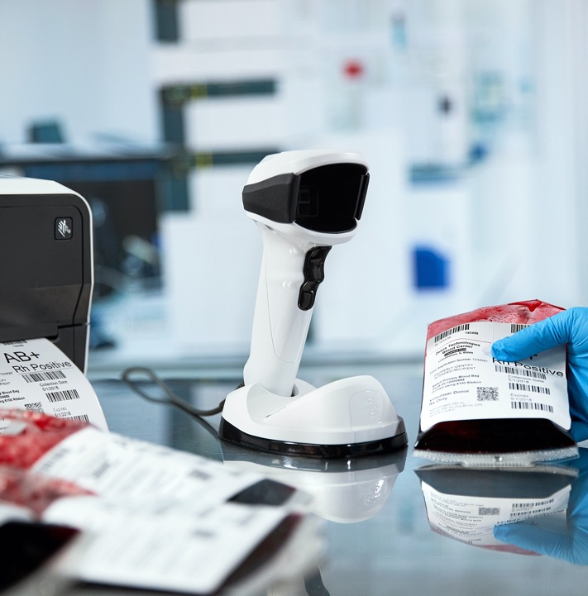
Patient Safety Driving Operational Shifts
Device ID
E-Health Recording
E-Pedigree
Vaccine Distribution

Slide 9
Challenges: A Deeper Look
Patient experience
Clinician workflow
Management
When scanners aren’t resistant to today’s toughest disinfectants, it introduces the potential of spreading infection
When scanners can’t capture a barcode, healthcare workers need to manually enter those barcodes, increasing the risk of human error
When clinicians need to focus on the scanner, they’re not focused on the patient
Healthcare providers need to be able to seamlessly capture UDI data. Medical device packaging labels include multiple UDI formatted barcodes, all of which need to be captured and parsed accurately. If workers need to enter information manually, it increases the chance of data entry error
Unplanned disruptions are caused by the short battery life of a scanner or the inability to gauge how much power is left
Clinicians’ workspaces are overrun with equipment
Organizations must allocate time and expense to deploy and manage a fleet of scanners spread across locations
Managing a battery sparepool adds more time and cost

Slide 10

Clinical Requirements
Must be clean and sterile
  Prevent the spread of germs
Sound Sensitive
  Loud sounds disturb NICU and resting patients
Workstations are compact and cluttered
  Small devices and cradles are required
Precise tracking is required for
patient safety
  Blood, patients, medications, medical devices and vaccines are tracked to prevent medical errors

Slide 11
1
2
3
4
5
Transform Operations with
Data Capture Solutions

Slide 12
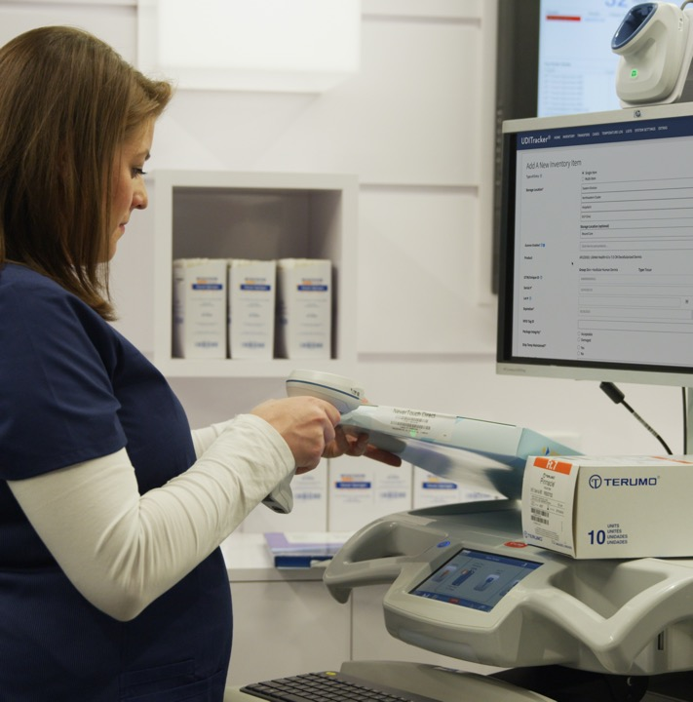
DCS is Visibility
Our customers aim to continuously improve productivity by gaining ever greater visibility to their critical assets.
Through the capture and conveyance of business-critical information at the point of activity, DCS devices lead to:
  Better information
  Better decisions
  Better outcomes

Slide 13
Meeting Customers’ Data Capture Goals
Fit-to-Application
Lowest
TCO
Best-in-Class
A broad portfolio of products to meet specific needs
1D, 2D, Digimarc, RFID
Many form factors – HH, HF, Fixed
Corded, cordless
Tiered portfolio tailored to applications/use cases
Products that are reliable and cost-effective throughout
the lifecycle
Less than .4% annual failure rate
Minimum processing time
Minimum power consumption
Superior performance through advanced technology
Best-in-class decode
Most advanced digital/optical designs
Highest resolution
image quality
Unmatched working range
Custom ASICs (barcode and RFID)
Comprehensive DataCapture DNA intelligent tools

Slide 14
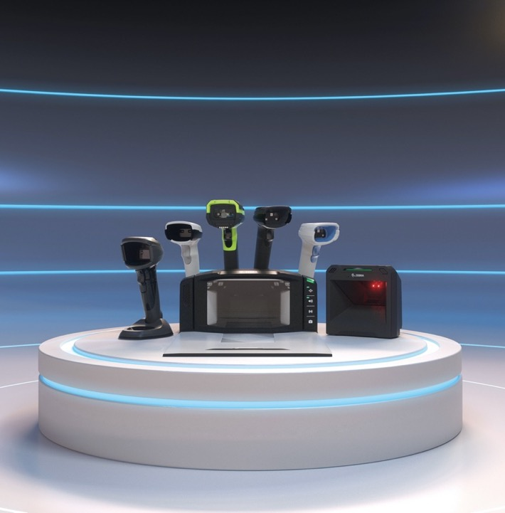
The Best Scanning Products
Supported by the Most Intelligent Tools
Smarter, faster, better scanning solutions
  Unrivalled performance and visibility
  Capture virtually any data in any condition
  UDI and blood bag formatting
Supported by DataCapture DNA
  Intelligent tools that simplify every stage of scanning
  Productivity tools, development tools, management tools, visibility tools
  Simplifies integration, management
  and usage
  Lowers total cost of ownership

Slide 15

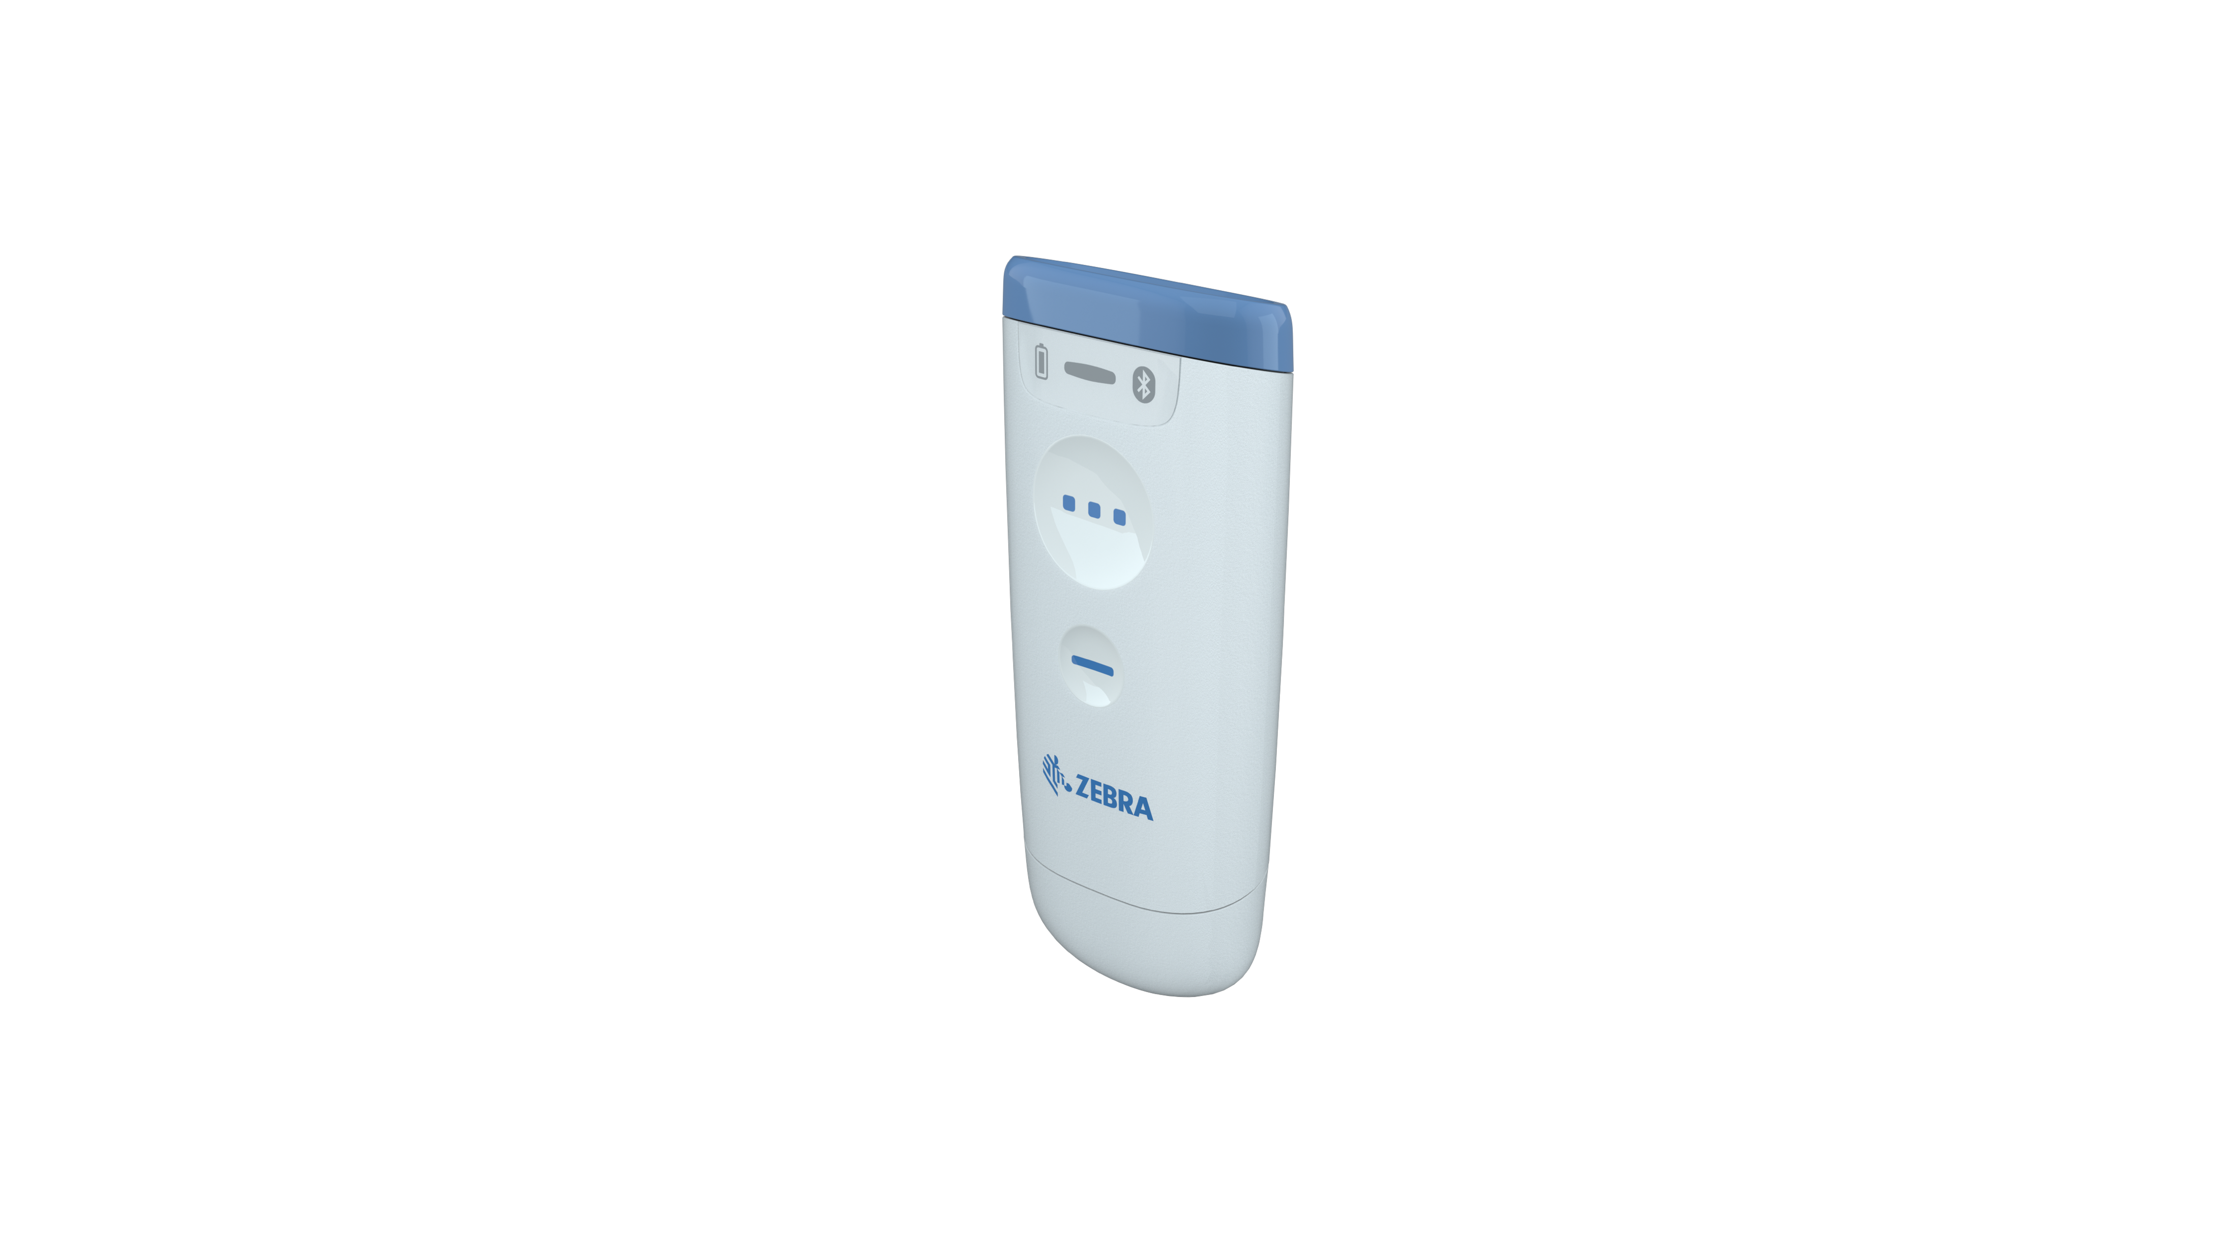



Innovative Hardware and Software Solutions
Attended
(Barcoding and RFID)
Unattended
(RFID and Vision)
Combine real-time and historic data to create a complete picture and intelligent insight for your customers
Tracking not only “what,” but “where,” “when,” and “what condition”
Real-time and unattended is the goal
Providing insight, not just data
Solution
Ecosystem
Data Analytics

Slide 16
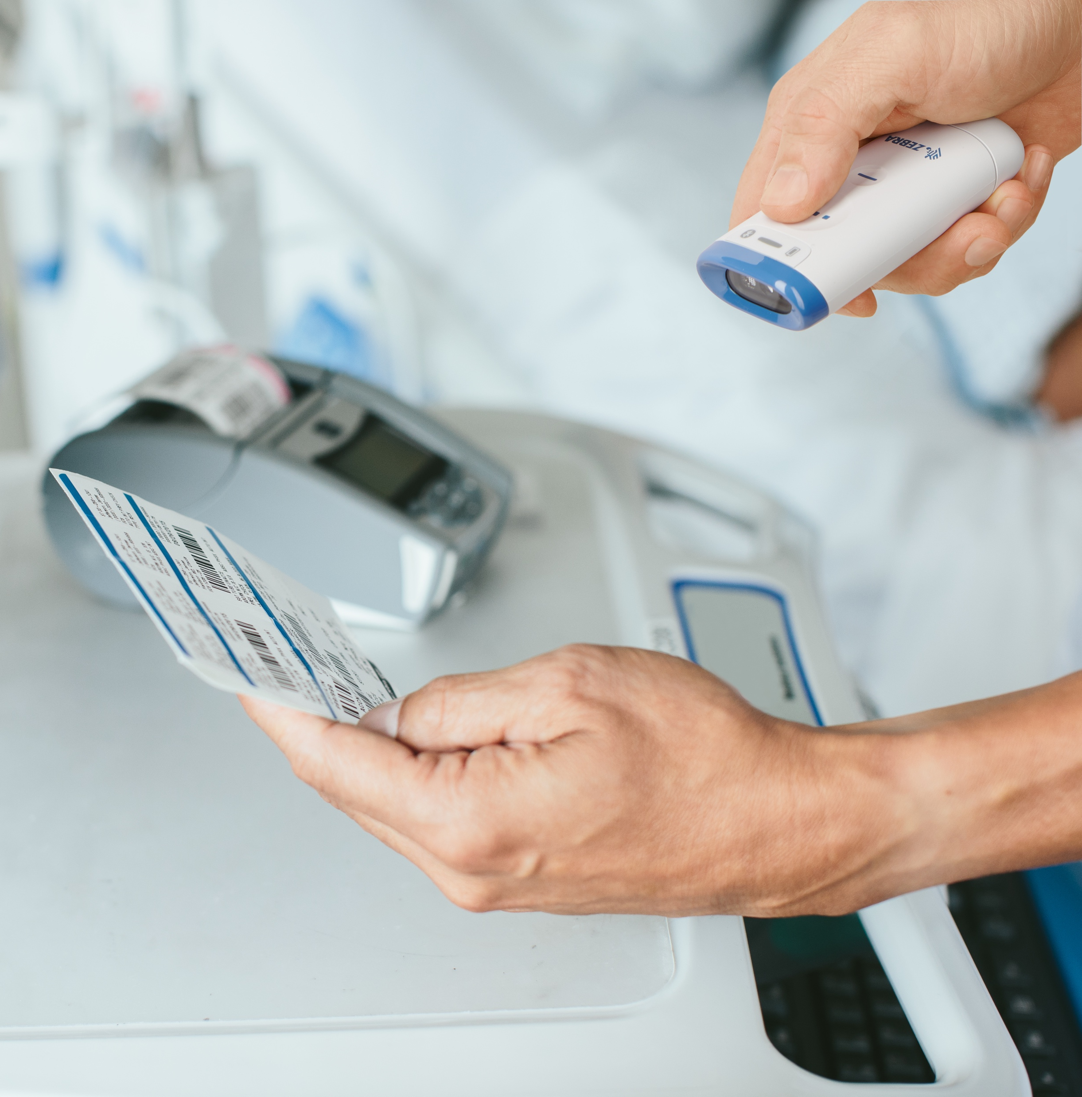
Zebra’s Healthcare Portfolio
Main Features:
Disinfectant-ready housing protects against the spread of infection
Easily capture and enter blood bag and UDI information into your application to improve efficiency and patient safety
Night Mode with vibrate avoids disturbing patients
Built-in work lamp illuminates a clinician's workspace
White illumination with green LED aimer is safe for use everywhere in the hospital – including the NICU
High density focus ideal for small, dense barcodes common in hospital environments
Feature availability varies by product

Slide 17
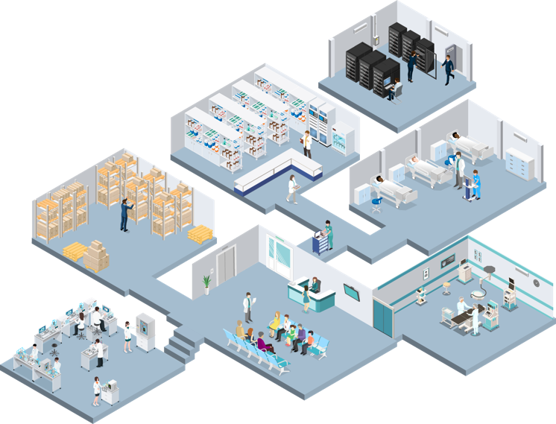










DCS Portfolio by Application
IT area
Pharmacy
Cordless Scanner in presentation cradle for meds dispensing/med packs
Receiving and Loading
Ultra-Rugged Scanner, Fixed Transition RFID Reader, RFID Handheld
Point of care
Handheld Scanner
Labs
Hands-Free Scanner, Fixed Transition RFID Reader
Operating Room
Handheld Scanner (Cordless)
Reception
Hands-Free Scanner

Slide 18
1
2
3
4
5
Portfolio and Products
for Healthcare

Slide 19















The DataCapture DNA family
Development Tools
Productivity Tools
Scanner Software Development Kits
Easily develop scanner applications with our SDKs for Windows, Linux, Android and IOS
Scanner Control Application
Connect a scanner to a mobile device to control features like the beeper and display scanned data
PRZM Intelligent Imaging
Faster, farther, smarter scanning with built-in intelligence
Multi-Code Data Formatting
Scan multiple barcodes with a single trigger pull
Wi-Fi Friendly Mode
Allow Bluetooth
scanners to operate on
Wi-Fi networks without interference
Preferred Symbol
Single out a barcode, while excluding the others
Scan-to-connect
In one step, connect your Bluetooth scanner to a phone, tablet or PC by simply scanning a STC barcode
Label Parse+
Instantly parse GS1 label barcode data to improve
quality control, inventory visibility and traceability
UDI Scan+
A single scan captures and parses UDI information for
your application
Blood Bag Parse+
Capture and parse barcode data on blood bags in one trigger pull
Visibility Tools
Management Tools
123Scan Utility
The industry’s easiest programming experience with 600,000+ loyal IT users
Remote Management
Choose between Zebra’s Scanner Management Service (SMS) – the simple alternative that lowers TCO or Windows Management Instrumentation
ScanSpeed Analytics
Identify and phase out
poor-performing barcodes to speed up checkouts
Remote Diagnostics
Slash TCO by validating the device is properly configured
19
ZEBRA TECHNOLOGIES

Slide 20
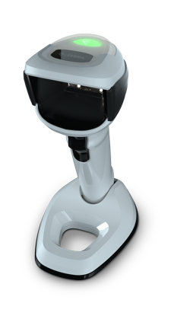
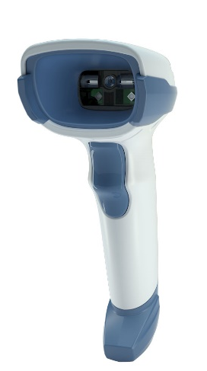
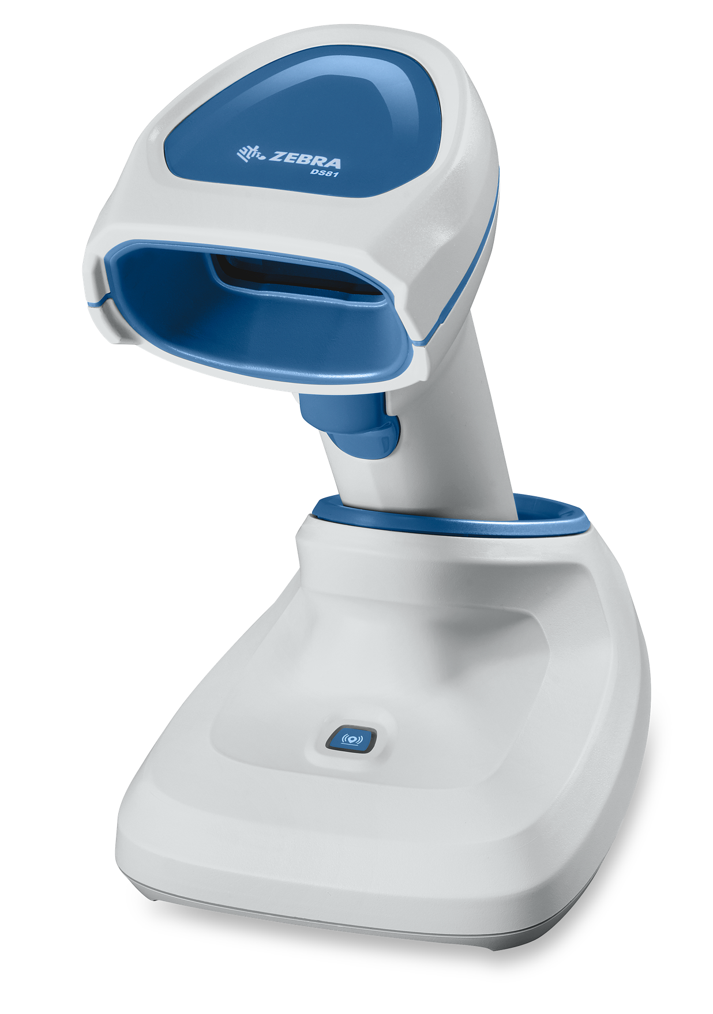
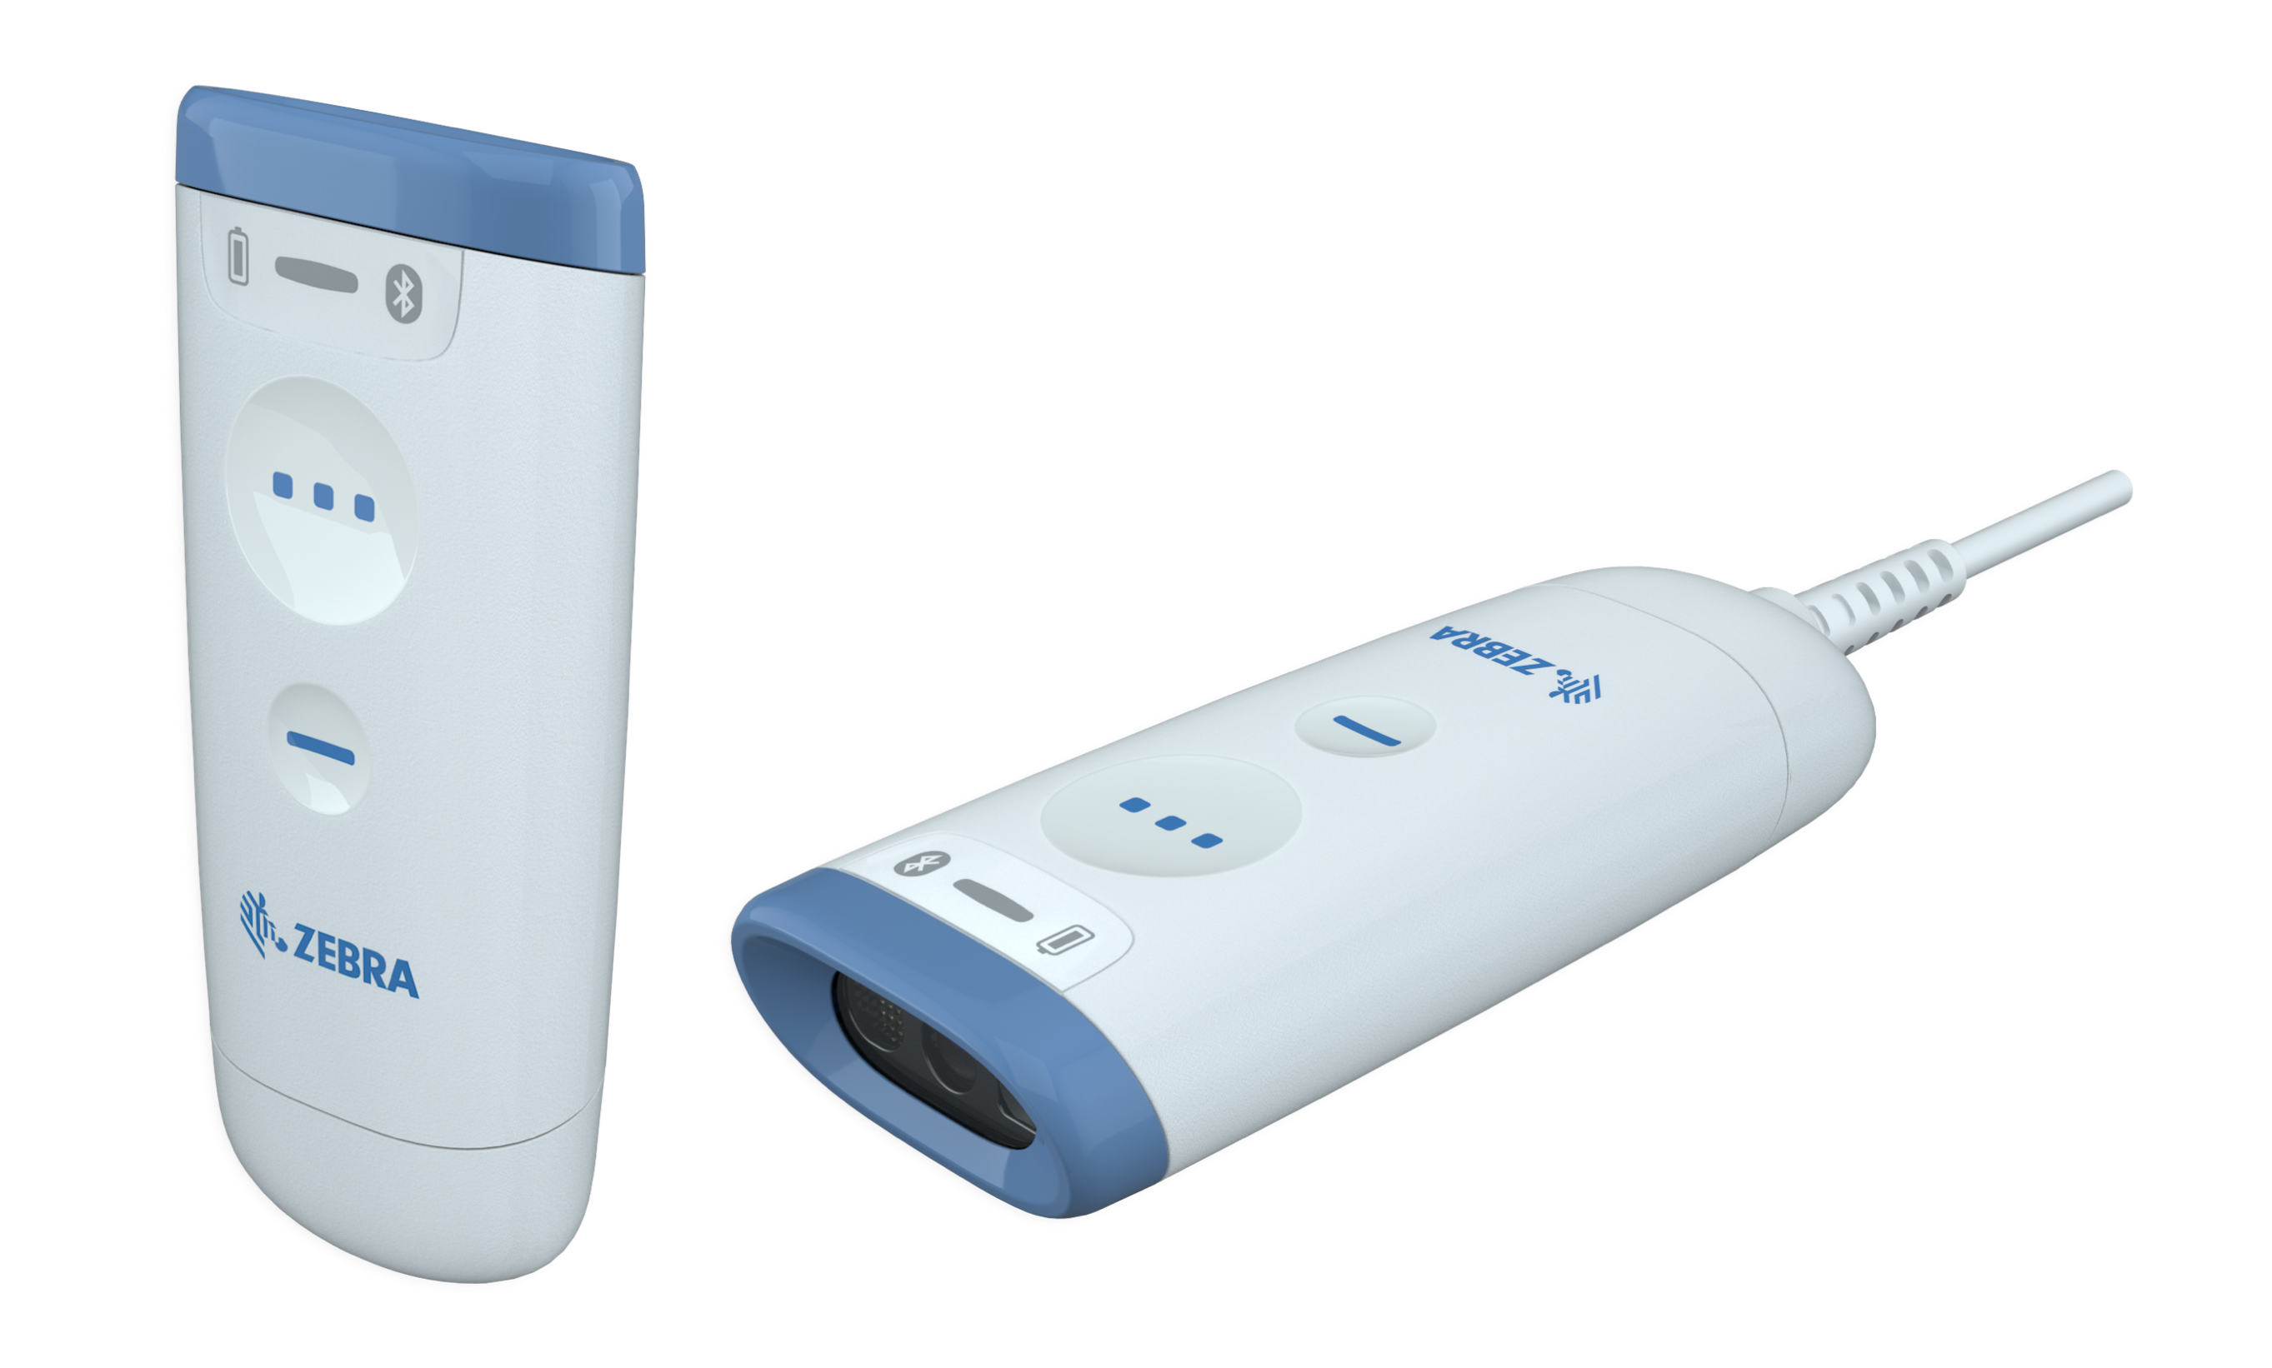
Zebra Healthcare Scanner Portfolio
ENTRY LEVEL
MIDRANGE
PREMIUM
PREMIUM LAB
COMPANION
DS2200 Series for Healthcare
Dependable, Affordable and Purpose-Built for Healthcare
DS4600 Series for Healthcare
Scanning Versatility for the Whole Hospital
DS8100 Series
for Healthcare
Improve Caregiving
DS9900 Series
Corded Hybrid Imager for Labs
Built for life in the lab
CS60-HC Series
Companion Scanner
Ultra-versatile with a first-of-its-kind convertible design

Slide 21
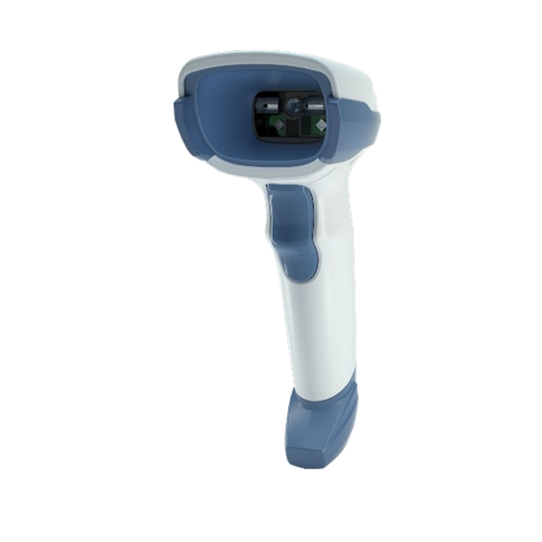

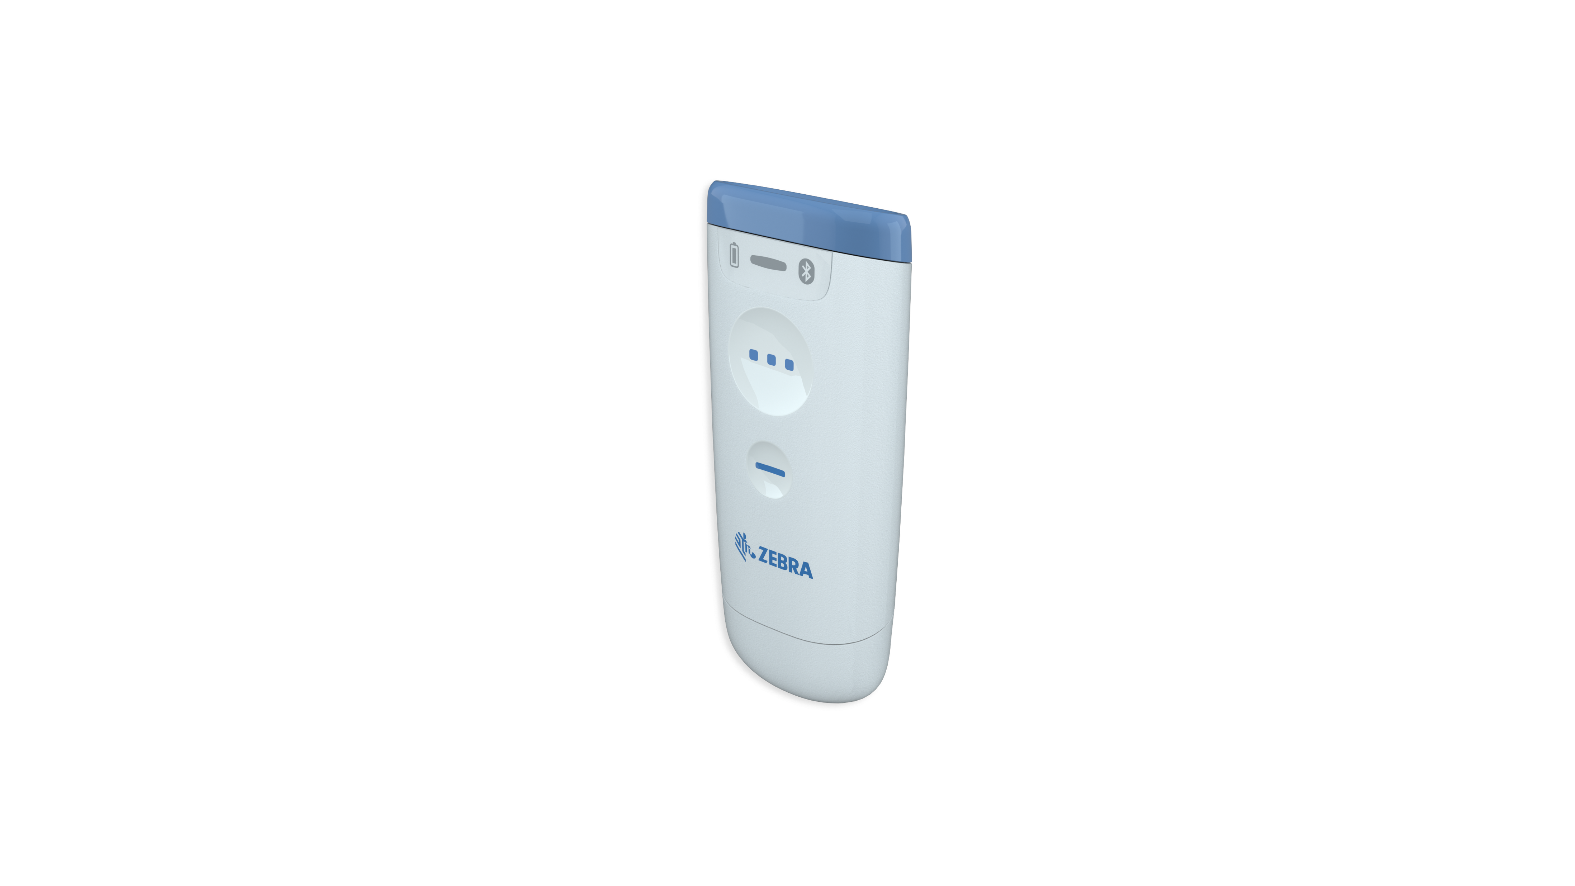
DataCapture DNA Enabled Scanners
Going beyond the barcode
 |  | DS2200-HC | DS4600-HC | DS8100-HC | DS9900-HD | CS60-HC
Management Tools | 123Scan Scanner Configuration | X | X | X | X | X
 | Remote Management (SMS/WMI) | X | X | X | X | X
 | PowerPrecision+ Battery | . | . | X | . | .
Visibility Tools | Remote Diagnostics | X | X | X | X | X
 | ScanSpeed Analytics | . | . | X | X | X
Productivity Tools | PRZM Intelligent Imaging | X | X | X | X | X
 | Multi-Code Data Formatting | . | X | X | X | X
 | Preferred Symbol | . | X | X | X | X
 | Wi-Fi Friendly Mode | X | . | X | . | X
 | Intelligent Document Capture | . | X | X | X | .
 | UDI Scan+ | . | X | X | X | X
 | Blood Bag Parse+ | . | X | X | X | X
 | Label Parse+ | . | X | X | X | X
Development Tools | Scanner Software Development Kits | X | X | X | X | X
 | Scanner Control Application | X | X | X | X | X
 | Scan-to-Connect Utility | X | . | X | . | X

Slide 22
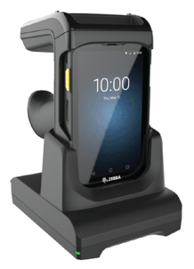
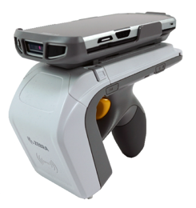
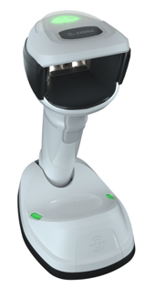
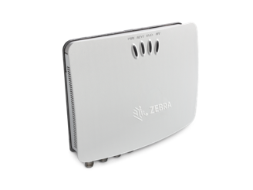
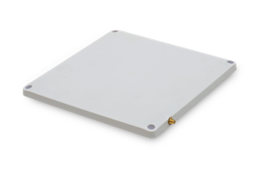
RFID Custom-made for Healthcare
RFD8500
Sled RFID / 1D / 2D Reader
Turn your computer into an
RFID reader
RFD2000
Sled RFID / 1D / 2D Reader
Turn Zebra’s TC20 into an
RFID reader
DS9908R
RFID / 1D / 2D Reader
Read RFID tags on blood bags and more
RFID Antenna
Ultra-rugged and low profile for use indoors and outdoors
FX7500 Fixed
RFID Reader
The small interior reader,
big on speed and accuracy

Slide 23





Why Zebra Gives You the Edge
Improve patient outcomes
Healthcare technology solutions that help you to improve patient care, reduce clinical errors and simplify clinician workflows
Energizing the enterprise
Solutions in healthcare, retail, transportation and logistics, and manufacturing that achieve a performance edge
Innovation that drives performance
Hundreds of engineers. Thousands of patents. Named one of Fast Company’s Most Innovative Companies
Global solutions trusted by the world’s largest organizations
With over 10,000 partners across 100 countries, delivering industry-tailored solutions that help customers to flourish
Comprehensive portfolio
Barcode scanning, barcode printing, mobile computing, RFID, locationing, data platforms, software, services, supplies

Slide 24
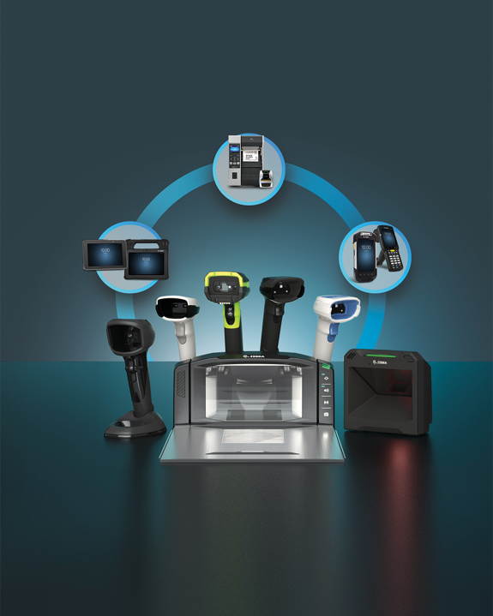
Zebra – Your Partner for Healthcare Data Capture Solutions and More
1
2
3
4
5
Talk to us about capturing
your performance edge
Contact your sales representative
or visit Zebra.com

