Slide 1

Data Capture in Retail
Data Capture in Warehousing
Gaining the Visibility that Drives Operational Efficiency

Slide 2
Agenda
1
Introduction to Zebra
2
Trends and drivers in warehousing
3
DCS Solutions that drive transformation in warehousing
4
Portfolio and products for warehousing applications
5
Zebra -your trusted partner for warehousing data capture and beyond

Slide 3








Customer-focused Innovation Behind 50 Years of Industry Firsts
Scanner development timeline*
Triggered handheld laser barcode scanner
Mobile computer combined with barcode scanning and wireless communications into one device
Frictionless scan element doesn’t wear out like conventional motors used in other laser scanners
Patented optics for SE95X Series of miniature scan engine with exemplary working range
Multi-plane imaging scanner with improved throughput due to capturing items from six different directions
1980
1986
1990
1991
1991
2003
2006
2010
2013
Introduced small formfactor laser scanner using laser diode
PDF417 symbology, found on almost every state driver’s license used today
Patented laser scan engine optics enables very long decode range
Hybrid Handheld/Handsfree 1D/2D barcode scanner UHF RFID reader for the POS
*Dates may reference entry to market

Slide 4
Introduction to Zebra
1
2
3
4
5

Slide 5
About Zebra Expertise
~$4.2B global sales
7000+ employees worldwide
10,000+ partners worldwide
Retail
Manufacturing
T&L
Healthcare
Data Capture Solutions
Mobile Computing
Specialty Printing
Location Solutions
Data Platforms
Software
Services
Supplies

Slide 6

Global Leadership Position
Handheld
Scan engine
RFID
4,600
National Medal of Technology Winner
US and international patents
issued and pending
Source: Market Share View, Q4’19 – Global

Slide 7
1
2
3
4
5
Trends and Drivers in Warehousing

Slide 8
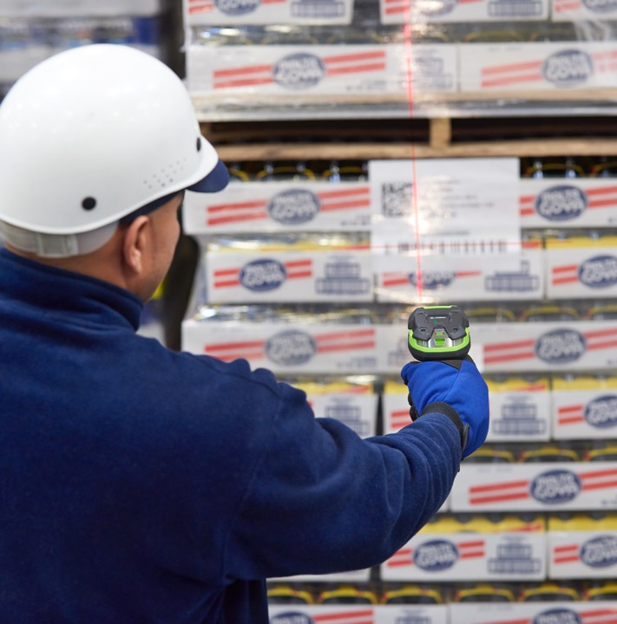
Unrelenting Pressure for Efficiency
Omnichannel
Nearshoring
Cross-docking
Item visibility
Real-time location
Automation

Slide 9

Trends in Warehousing
Warehouse operations must keep pace by solving today’s challenges:
Isolated systems and internal/external visibility gaps
Labor shortages and more volume
Disconnected workers and workflows
Bottlenecks and asset inventory blind spots
Rising workflow complexity
Errors and non-compliance

Slide 10
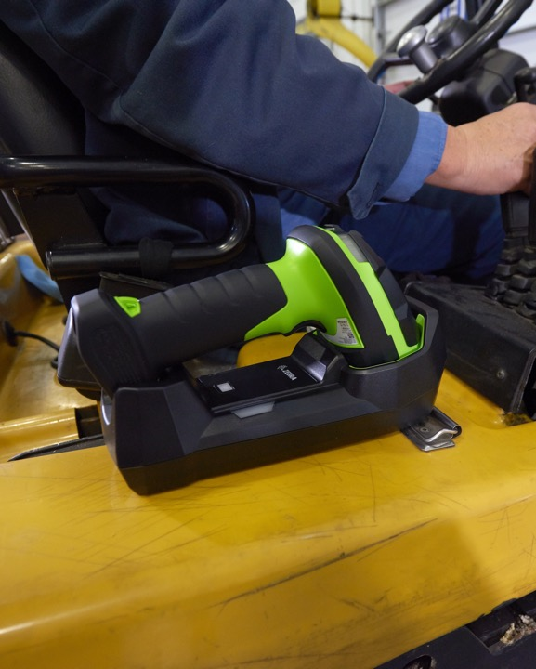
Trends in Warehousing
Customers expectations outside the warehouse demand more, so pressure is increased inside the warehouse to process more
Order volume is at an all-time high, days have turned into hours and picking accuracy is vital
Omnichannel transactions, increasing SKUs and customer demands call for efficiency across warehouse workflows

Slide 11
Key Drivers in Warehousing
Profitable omnichannel
Accurate inventory
Tracking
Visibility
Creating a profitable omnichannel operation is critical
Accurate inventory is vital to ensure customers get the products they want
Instant access and availability to tracking
Complete visibility from order placement to delivery

Slide 12
1
2
3
4
5
Transform Operations with
Data Capture Solutions

Slide 13

DCS is Visibility
Our customers aim to continuously improve productivity by gaining ever greater visibility to their critical assets.
Through the capture and conveyance of business-critical information at the point of activity, DCS devices lead to:
  Better information
  Better decisions
  Better outcomes

Slide 14
Meeting Customers’ Data Capture Goals
Fit-to-Application
Lowest
TCO
Best-in-Class
A broad portfolio of products to meet specific needs
1D, 2D, Digimarc, RFID
Many form factors – HH, HF, Fixed
Corded, cordless
Tiered portfolio tailored to applications/use cases
Products that are reliable and cost-effective throughout the lifecycle
Less than .4% annual failure rate
Minimum processing time
Minimum power consumption
Superior performance through advanced technology
Best-in-class decode
Most advanced digital/optical designs
Highest resolution image quality
Unmatched working range
Custom ASICs (barcode and RFID)
Comprehensive DataCapture DNA intelligent tools

Slide 15
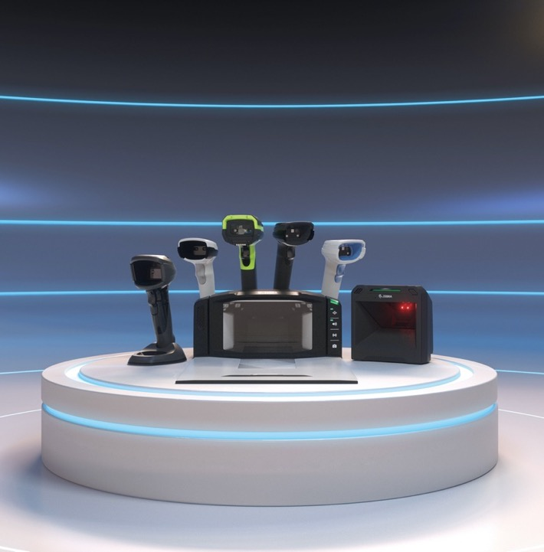
The Best Scanning Products
Supported by the Most Intelligent Tools
Smarter, faster, better scanning solutions
  Unrivalled performance and visibility
  Capture virtually any data in any condition
Supported by DataCapture DNA
  Intelligent tools that simplify every
  stage of scanning
  Productivity tools, development tools, management tools, visibility tools
  Simplifies integration, management
  and usage
  Lowers total cost of ownership

Slide 16



Innovative Hardware and Software Solutions
Attended
(Barcoding and RFID)
Unattended
(RFID and Vision)
Combine real-time and historic data to create a complete picture and intelligent insight for your customers
Tracking not only “what,” but “where,” “when,” and “what condition”
Real-time and unattended is the goal
Providing insight, not just data
Solution
Ecosystem
Data Analytics

Slide 17
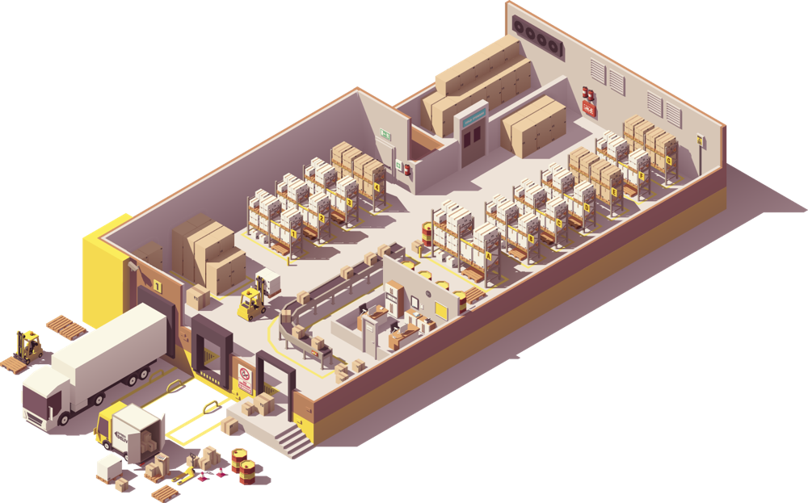







DCS Portfolio by Application
Backroom Shipping and Receiving
Ultra-Rugged Scanner; Fixed Transition RFID Reader
Dock Doors/Staging Area
SmartPack & MotionWorks
Stock (Picking)
Ultra-Rugged Scanner; RFID Handheld
IT Area
123Scan, Remote Management, ScanSpeed Analytics, 123RFID

Slide 18
1
2
3
4
5
Portfolio and Product for Warehousing Applications

Slide 19












The DataCapture DNA Family
Productivity Tools
Development Tools
PRZM Intelligent Imaging
Faster, farther, smarter scanning with built-in intelligence
Multi-Code Data Formatting
Scan multiple barcodes with a single trigger pull
Intelligent Document Capture
Instantly capture and
optimize full-size documents, while processing barcodes
Scanner Software Development Kits
Easily develop scanner applications with our SDKs for Windows, Linux, Android and iOS
Scanner Control Application
Connect a scanner to a mobile device to control features like the beeper and display scanned data
Scan-to-Connect
Connect your Bluetooth scanner to a phone, tablet or PC by simply scanning
a STC barcode
Preferred Symbol
Single out a barcode, while excluding the others
UDI Scan+
Unlock the benefits of UDI (Unique Device Identification)
Wi-Fi Friendly Mode
Allow Bluetooth scanners to operate on Wi-Fi networks without interference
Management Tools
Visibility Tools
123Scan Utility
The industry’s easiest programming experience with 600,000+ loyal IT users
Remote Management
Choose between Zebra’s Scanner Management Service (SMS) – the simple alternative that lowers TCO or Windows Management Instrumentation
ScanSpeed Analytics
Identify and phase out
poor-performing barcodes to speed up checkouts
Remote Diagnostics
Slash TCO by validating the device is properly configured

Slide 20
Scanners Purpose-built for Warehousing
3600 Series Ultra-Rugged Scanner
Be unstoppable with relentless performance
LI3608-SR LI3678-SR | DS3608-SR DS3678-SR | DS3608-HP DS3678-HP | LI3608-ER LI3678-ER | DS3608-ER DS3678-ER
1D Linear | 2D Standard Range | 2D High Performance | 1D Long Range | 2D Long Range
Standard Range 1D linear imager, Reads off LCD | Standard Range Reads off LCD, Basic Image capture, LED aimer | Mid Range Reads off LCD, OCR, Doc Cap, Advanced Image capture, Signature capture, Laser Aimer | Extended Range 1D (Long Range) Reads off LCD | Extended Range 2D (Long Range) Reads off LCD, Basic image capture
Near field reading, Shipping and Receiving on loading docks and receiving dock doors. Small Item pick and pack, Mfg WIP. | Near field 2D reading, Shipping and Receiving on loading docks and receiving dock doors. Small Item pick and pack, Mfg WIP. | Mid-Range reading for reading large items on loading docks for shipping and receiving. Package / Courier services poof of delivery / image capture. | Picking, Forklift applications, WH /DC, Transportation Cross dock | Picking, Forklift applications, WH /DC, Transportation Cross dock

Slide 21
DataCapture DNA Enabled Scanners
Going beyond the barcode
 |  | Ultra-Rugged
 |  | DS3608/DS3678 | LI3608/LI3678
Management Tools | 123Scan Scanner Configuration | X | X
 | Remote Management (SMS/WMI) | X | X
 | PowerPrecision+ Battery | X | X
Visibility Tools | Remote Diagnostics | X | X
 | ScanSpeed Analytics | X | X
Productivity Tools | PRZM Intelligent Imaging | X | .
 | Multi-Code Data Formatting | X | .
 | Preferred Symbol | X | .
 | Wi-Fi Friendly Mode | X | X
 | Intelligent Document Capture | X | .
 | UDI Scan+ | coming soon | .
Development Tools | Scanner Software Development Kits | X | X
 | Scanner Control Application | X | X
 | Scan-to-Connect Utility | X | X

Slide 22
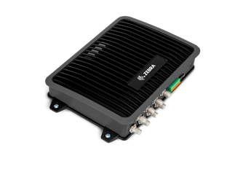
RFID Custom-made for Warehousing
ATR7000
Pinpoint location of all of your tagged assets
MC3330R
RFID / 1D / 2D Reader
Less trekking, more tracking
MC3390R
RFID / 1D / 2D Reader
Zero in on distant items with zero effort
FX9600 Fixed RFID Reader
Top of the line performance for high-volume rugged environments

Slide 23
Zebra Intelligent Edge Solutions
SmartPack
Bring visibility that's visionary into loading operations

Slide 24





Why Zebra Gives You the Edge
Exceed customer expectations
Warehousing technology solutions that help you to exceed expectations and boost efficiency, productivity and profitability
Energizing the enterprise
Solutions in warehousing, transportation and logistics, manufacturing and retail that achieve a performance edge
Innovation that drives performance
Hundreds of engineers. Thousands of patents. Named one of Fast Company’s Most Innovative Companies
Global solutions trusted by the world’s largest organizations
With over 10,000 partners across 100 countries, delivering industry-tailored solutions that help customers to flourish
Comprehensive portfolio
Barcode scanning, barcode printing, mobile computing, RFID, locationing, data platforms, software, services, supplies

Slide 25
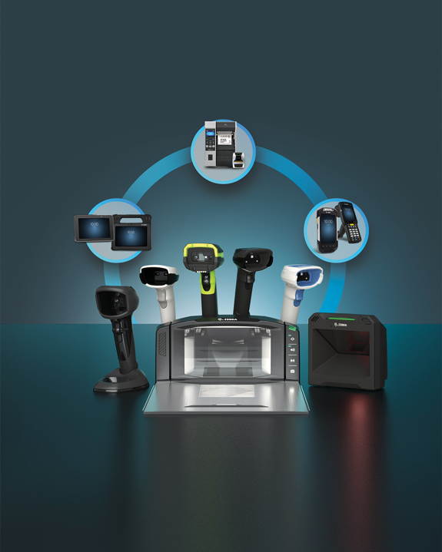
Zebra – Your Partner for Warehousing
Data Capture Solutions and More
1
2
3
4
5
Talk to us about capturing
your performance edge
Contact your sales representative
or visit Zebra.com

